Slide 1
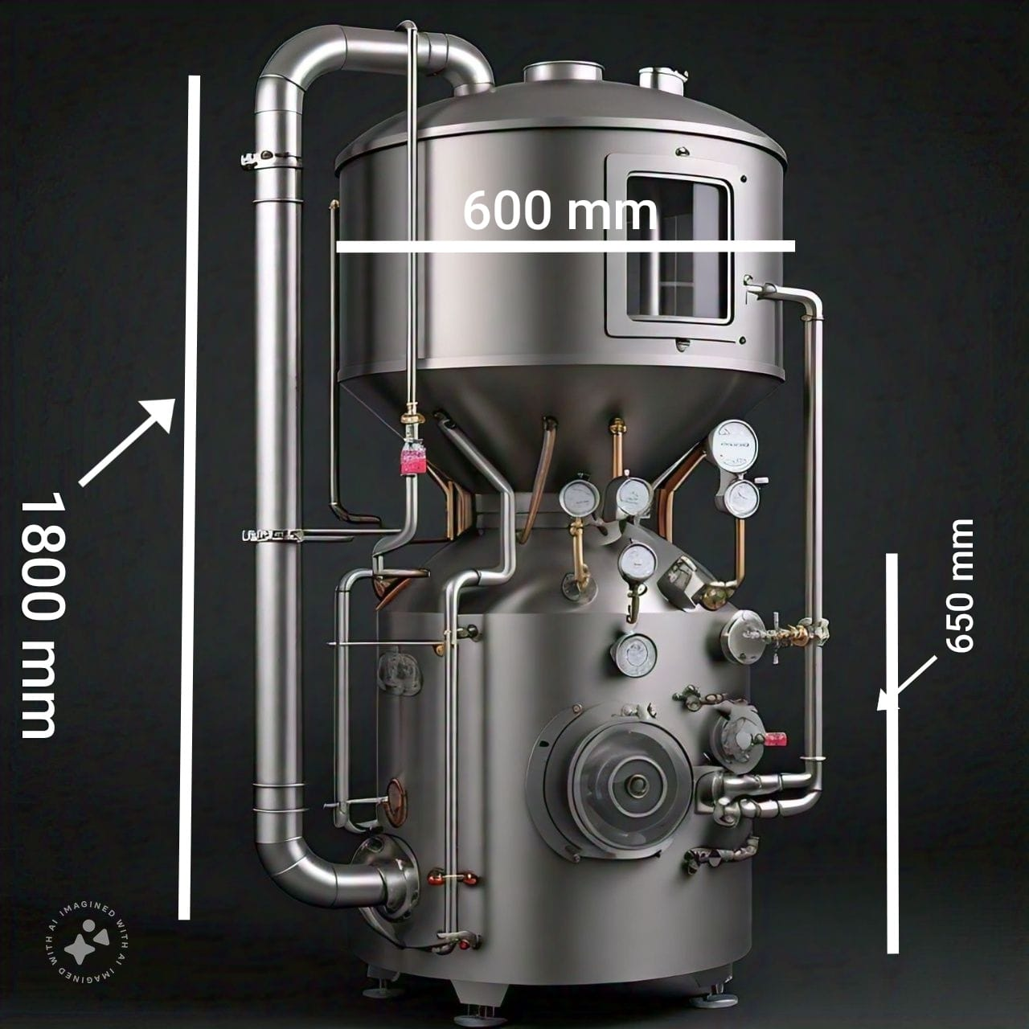
Project proposal
CO2 SCRUBBER
SCOPE: design and develop
regenerative and Non-regenerative
Co2 scrubber system.
PRESENTED BY : SOPANEE INFRA PVT LTD

Slide 2
PRESENTATION
INDEX
PROBLEM STATEMENT
OVERVIEW OF THE CO2 SOURCES
AVAILABLE SOLUTIONS FOR CO2 SCRUBBING
OUR DESIGN PROPOSAL
BASIS OF SELECTION
OUR DESIGN USP
SCALABILITY OF THE PRODUCT IN TERMS OF SALES

Slide 3
PROBLEM STATEMENT
1. To maintain tenable conditions inside n.b.c. shelters by scrubbing co2, exhaled by humans or any other co2 generating source.
2. To scrub co2 from industrial exhausts to achieve net zero carbon targets set by the state or govt. and help the world minimize greenhouse effect.

Slide 4
OVERVIEW OF THE CO2 SOURCES

Slide 5

PROJECT GOAL
IN SHELTERS
EXPEDITIONS
ENVIRONMENT
INDOORS
INDUSTRIAL
Preventing CO2 Buildup in Confined Spaces
Supporting Life in Space and Underwater by scrubbing CO2
To support in Net Zero Carbon Compliance.
Improving Indoor Air Quality with Air Filters Units
Supporting Chemical and Biological Processes by recycling CO2

Slide 6
CO2 SCRUBBING MATERIALS
CO2 SCRUBBING METHODS
Soda Lime (CaO)
Lithium Hydroxide (LIOH)
Mono-ethanol
-amine (MEA)
Calcium Hydroxide (CAOH)
Magnesium Hydroxide (MGOH)
ADSORPTION
SOLID ADSORPTION METHODS
LIQUID ADSORPTION METHODS
PRESSURE SWING ADSORPTION
REGENERATIVE
ABSORPTION
LIQUID ABSORPTION METHODS
Zeolites

Slide 7
OUR DESIGN PROPOSAL – LIQUID SORBENT BASED CROSS AIR FLOW SCRUBBER
The developed units will be modular type, where the main scrubbing module will only scrub and store the co2 in the form of co2 saturated absorbent/ adsorbent material. This unit will be compact, fully automated, seamless integrated with BMS, with least maintenance requirement.
the second module will be a regeneration unit with co2 extraction, compression and storing facility into cylinders. The design will be compact, automated and scalable so that the regeneration rate is modulated to match the consumption by multiple scrubbing module as per requirement.
both modules will be capable of independent operation.

Slide 8
OUR DESIGN USP
Does not require large blowers and compressors that need to force air at high velocities through typical CO2 removal systems.
Offers a reliable, compact and efficient design: offers low weight, volume, and power requirements.
Presents improvements over current technologies: Liquid sorbents have favorable capacity, up to four times greater than current solid zeolites
Facilitates simple regeneration techniques: Liquid sorbents have low regeneration temperatures, so the materials do not need to be heated to extreme temperature

Slide 9

DESIGN AND DEVELOPMENT ROADMAP
Concept design
simulations
Prototype development
testing
Product manufacturing
Develop concept
Theoretical validation
Automation Logic
3D modelling
CFD analysis
Product Design
3D Printing / Fabrication
Internal Testing
External Testing
Certifications/ Patents
Set up manufacturing unit.
Product Rollout

Slide 10
SCALABILITY OF THE PRODUCT IN TERMS OF SALES
INDUSTRIAL APPLICATION AND BUISNESS POTENTIAL
Maritime Industry
Aerospace Industry
Emergency Breathing Manufacturers
Medical Industry
Mining Industry
Tunneling Industry
Defence and Military
Diving Equipment Manufacturers
Industrial Gas Processing
Manufacturers of Portable Respirators

